Slide 1
Help Purple

Slide 2
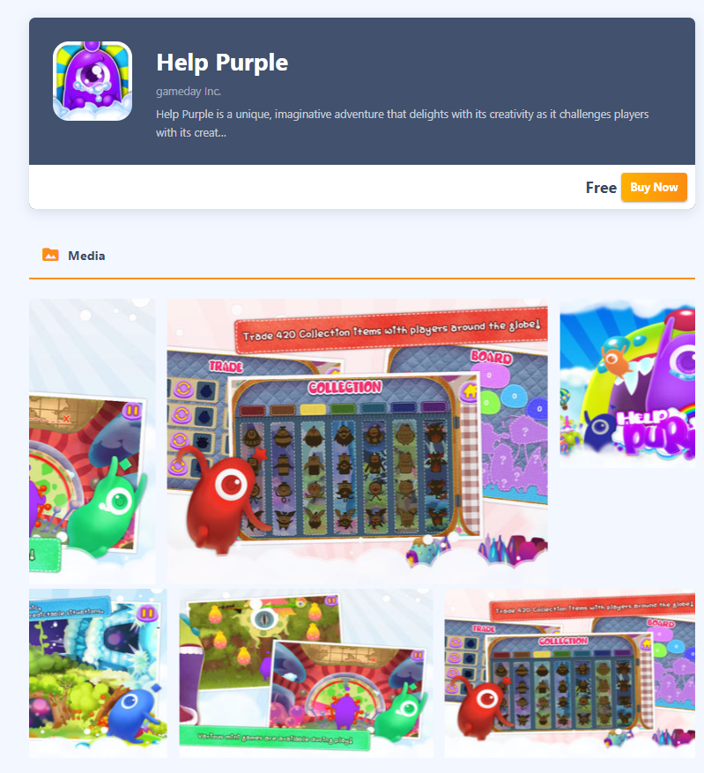
What does the player do?
Similar to games such as Candy Crush, Help Purple requires players to analyze, assess and solve the puzzles to help purple move

Slide 3
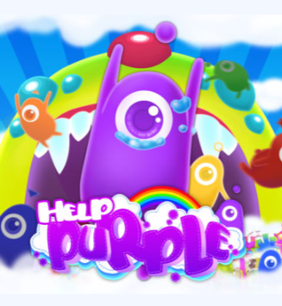
Colours
Vibrant and complimentary colors are used in this game.
Comparing to our game which also uses vibrant and complementary colors so this helps prove that we are hitting the right target audience

Slide 4
Characters
In the forum I found that players really enjoyed the cuteness of the characters and they love the interactions which are produced from the creatures.
They also loved the cute animations which the creatures perform during certain events and it helps give them personality resulting in more connection between them and the player

Slide 5
Their Community Forum
https://toucharcade.com/community/threads/help-purple-by-gameday-please-help-purple.124164/

Slide 6
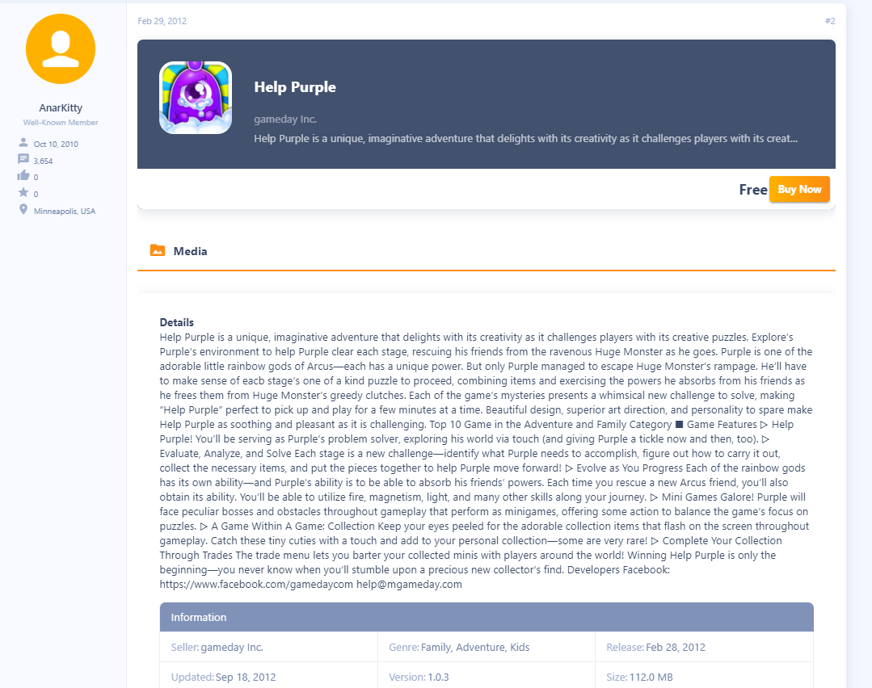
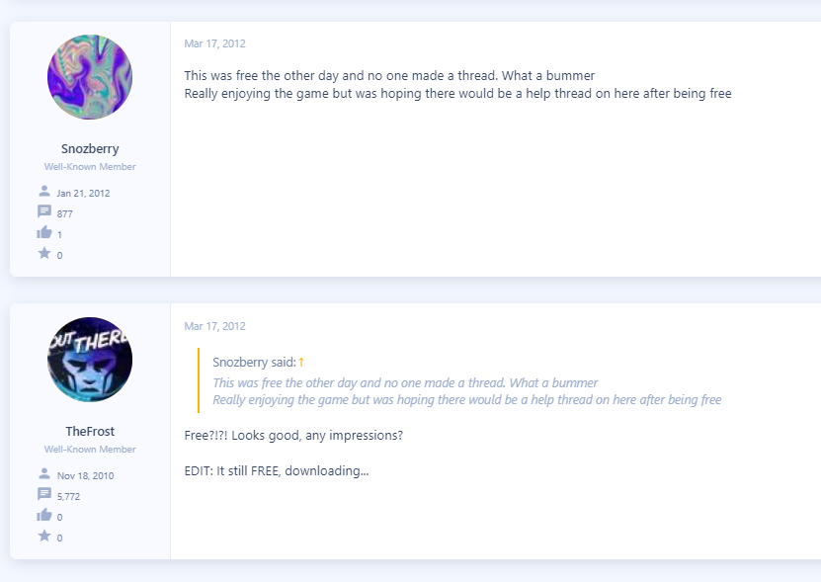
Some Comments From the Forum

